Slide 1
PRESCRIPTION AUDIT
DR.SELVARAJU
ASSISTANT PROFESSOR
DEPARTMENT OF PHARMACOLOGY

Slide 2
PH 3.2
Perform and interpret a critical appraisal (Audit) of a given prescription
Given here is a prescription written for a 40 years old man suffering from loss of appetite, dyspepsia and pain in upper abdomen after taking meals for the past 5 days . After clinical examination and investigations he is diagnosed to be suffering from Acid peptic disease . Critically audit/evaluate it and write the correct prescription.
Dr. XXX MBBS.,MD.,
Reg.No : 226543
Tab. Pantop 40mg od for 10 days
Tab. Multivit od for 10 days
Tab. Aceclofenac 100mg bid for 3 days.

Slide 3
1. Date of prescription is not given
2. Complete details of the doctor like address, phone number are not given
3. Details of the patient is not given
4. Diagnosis is not given
5. The superscription symbol R_{x} is missing.
6. In the inscription name of the drugs (Pantop,Multivit) are in brand name. They are not written in capital letters. Aceclofenac being a NSAID is contra-indicated in this patient as it will aggravate the disease. It is irrational to prescribe multivitamin to this patient.
7. The subscription i.e instruction to the pharmacist is not given
8. The transcription or instruction to the patient is missing.
9. Refill instruction is not given
10. Signature of the physician is not present.

Slide 4
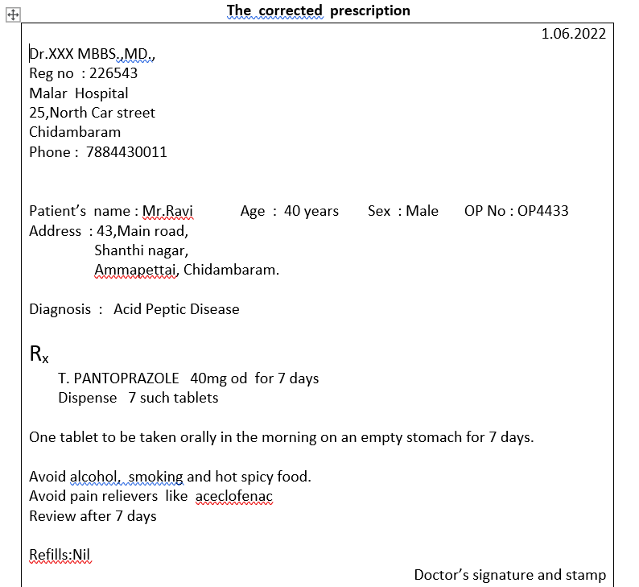

Slide 5
2. Given here is a prescription for a 4 years old male child weighing 15kg suffering from diarrhoea for
the past 2 days . He passed 4 to 5 motions in one day. No H/O fever and vomiting. After thorough
examination the child was diagnosed to have diarrhoea.
Critically evaluate (Audit) it and write the correct prescription.
1.06.2022
Dr.XXX MBBS.,MD.,
Reg no : 226543
Malar Hospital
25,North Car street
Chidambaram
Phone : 7884430011
Patient’s name : Baby.Rohit
T. Crocin 250mg bid for 2 days
Syr.Metrogyl (2oomg/5ml) 7.5ml bid for 5 days.

Slide 6
1. Details of the child is not complete
Diagnosis is not written
3. The superscription symbol R_{x} is not present
4. In the inscription the names of the drugs are in brand name and they are not written in capital
letters . This child does not have fever, hence prescribing pareacetamol (crocin) is irrational. The
child suffers from diarrhea only, hence prescribing anti-amoebic drug metronidazole is irrational.
WHO ORS and Zinc are missing in the prescription.
5. Subscription is missing
6. Instruction to the patient is not written
7. Refill instruction is not given
8. Signature of the physician is missing.

Slide 7
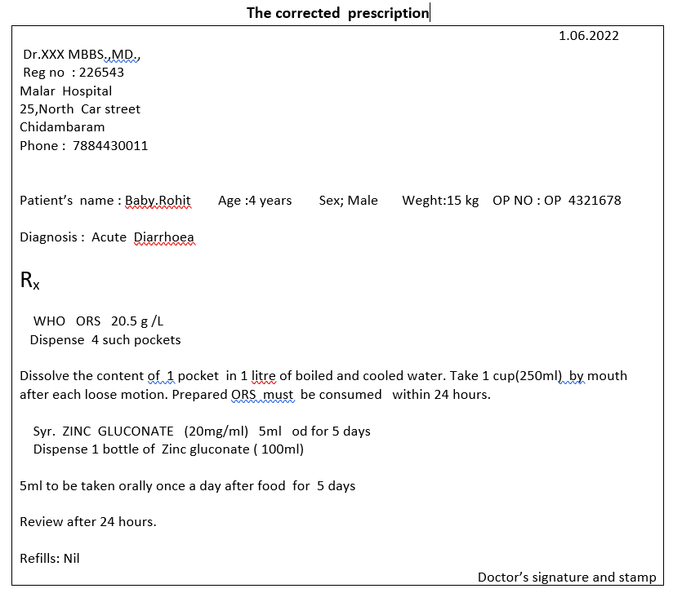

Slide 8
3. Given here is a prescription written for a 24 years old woman suffering from throbbing
headache on one side lasting for 8hours and vomiting, associated with sensitivity to light
and sound. She had similar episode 2 months back. After thorough examination she was
diagnosed to have Migraine.
Critically evaluate it and write the correct prescription
Dr.xxx
Phone : 7154389009
Patient’s name: Mrs.Kamala Age:24 years Sex:Female Weight:65kg
OP NO: OP 887766
T.Sumatriptan 100mg tid
T.Propranolol 40mg o.d
T.Ergotamine 2mg IV

Slide 9
1.The date of prescription is not given
2. Details of the doctor is not complete
3. Diagnosis is not written
4. The superscription symbol R_{x} is not present
5. In the Inscription the name of the drugs are not in capital letters. Dose of sumatriptan is high. Duration of drug therapy is not given. The patient should either receive Sumatriptan or Ergotamine. Sumatriptan and Ergotamine should not be given together. Sumatriptan is equally effective and better tolerated. This patient needs anti emetic as there is vomiting. Patient also needs additional NSAID combination. Propranolol is not needed. It is given as prophylactic therapy when attacks are more frequent than 2 to 3 per month.
6. Subscription is missing
7. Instruction to the patient is not written
8. Refill instruction is not given
9. Signature of the physician is missing.

Slide 10
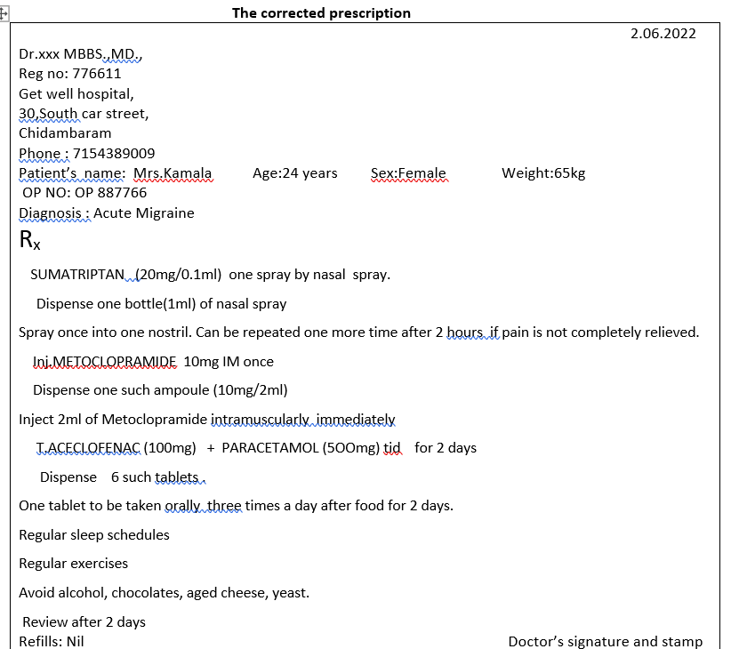

Slide 11
4. A 40 years old male ,a known case of Gout on T.Allopurinol approached his family physician with symptoms of Acute Tonsillitis. The physician wrote the following prescription. Critically audit it and write the correct prescription.
T. Allopurinol 100mg bid
Cap.Ampicillin 500mg tid

Slide 12
1. Date of prescription is not given
2. Details of the prescriber and patient are not given
3. Diagnosis is not written
4. The superscription symbol R_{x} is not given
5. In the inscription the names of the drugs are not in capital letters. Duration of drugs therapy is not given. A higher incidence of skin rashes has been reported when ampicillin is given to patients on allopurinol. Hence ampicillin can be replaced with amoxicillin which is equally effective but does not produce skin rashes.
6. Subscription is missing
7. Instruction to the patient is not written.
8. Refill instruction is not given
9. Signature of the physician is missing.

Slide 13
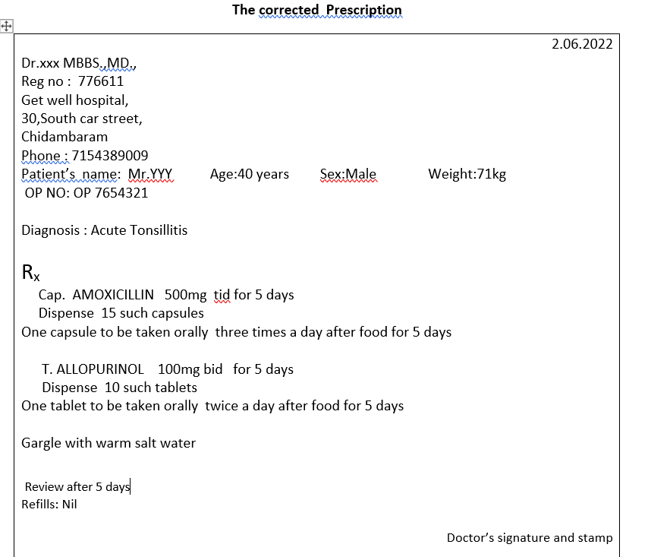

Slide 14
5. A 54 years old male, known Type-II Diabetic was well controlled with T.Glimepiride and
T.Metformin. Recently he developed Stage-I hypertension and the physician prescribed the
followimg anti-hypertensive drug. Perform a prescription audit and suggest changes for rational
therapeutics.
2.06.2022
Dr.xxx MBBS.,MD.,
Reg no : 654321
Get well hospital,
30,South car street,
Chidambaram.
Phone : 7154389009
Diagnosis : Hypertension with Type II diabetes mellitus
R_{x}
T.Glimepiride img od for 15 days
T.Metformin 5oomg bid for 15 days
T.Propranolol 40mg bid for 15 days

Slide 15
1.Details of the patient is not given
2.In the inscription the names of the drugs are not written in capital letters. Non selective beta blockers block the symptoms of hypoglycemia and worsen the hypoglycemic episodes,hence avoided in diabetics. Suggested alternative is either ACE—I or ARB which are renoprotective in type II diabetes mellitus.
_{3.} Subscription is missing
4. Instruction to the patient is not written.
5. Refill instruction is not given
6. Signature of the physician is missing

Slide 16
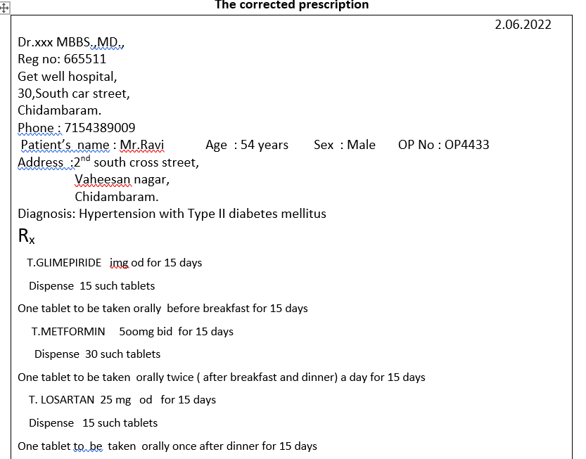
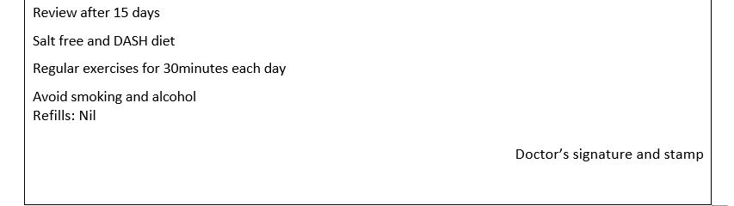

Slide 17
5.Written here is a prescription for a 27 years old primi woman in her first trimester suffering from mild iron deficiency anaemia . Comment, correct and rewrite the prescription.
Mrs .Kamala Age:27years Sex: Female Weight:65kg OP NO: OP665123
Address: 24, North cross street ,
Gandhi nagar,
Chidambaram
Inj. Microfer 1 amp i.m daily for 7 days
Fersolate 400mg t.i.d for 30 days
Folic acid 100mg t.i.d for 30 day

Slide 18
1. Date of prescription is not given
2. Details of the prescriber is not written
3. Diagnosis is not written
4. The superscription symbol R_{x} is not given
5. In the inscription The names of the drugs ( Microfer,Fersolate) are given in brand name.The drugs’ names are not written in capital letters. Patient is suffering from mild anaemia, so parenteral iron therapy is not needed. Dosage of ferrous sulphate ( Fersolate) and folic acid are wrong .Formulaitons of ferrous sulphate and folic acid are not given.
6. Subscription is missing
7. Instruction to the patient is not written.
8. Refill instruction is not given
9. Signature of the physician is missing

Slide 19
